Slide 1



Mastercard Visit - <POC Caption>
March 28th, 2025

Slide 2

Agenda
01 | Problem Statement / Challenges
02 | Current Process
03 | To be Process
04 | Envisaged Benefits
05 | Support Needed

Slide 3

What we heard.
Problem Statement & Current Process
Mastercard utilizes a remedy system to track production TAS (Ticketing and Support) tickets. Currently, there is no consolidated knowledge base for previously reported issues, leading to increased turnaround times for customer queries for repetitive issue .
During Ticket Lifecycle ,When the CTS (Customer Technical Support) team reports a new issue, the DAS (Development and Support) team creates a TAS ticket and attempts to analyse and resolve the issue. If the DAS team cannot resolve the issue, they escalate it to the Dev Team for further analysis.

Slide 4
What we heard.
To Be Process
To address the issue of repetitive TAS tickets and improve turnaround times for customer queries, we propose developing a recommendation bot using the Spring AI Retrieval Augmented Generation (RAG) technique. This bot will leverage the existing TAS Ticket knowledge base and Chargeback Guide to recommend probable solutions to newly reported TAS tickets using OpenAI's Large Language Model (LLM).
Key Features:
Spring AI RAG Integration:
Learning from Existing Knowledge Base: The bot will be trained on the TAS Ticket knowledge base and Chargeback Guide to understand and retrieve relevant information.
Contextual Recommendations: By querying the vector database, the bot will provide contextually relevant solutions to reported issues.
Local LLM Integration:
Secure Data Processing: Utilizing local LLM integration like Ollama ensures that data is processed within a secure local environment, maintaining data privacy and security.
Efficient Query Handling: The local LLM will handle queries efficiently without the need to send data to external servers.

Slide 5
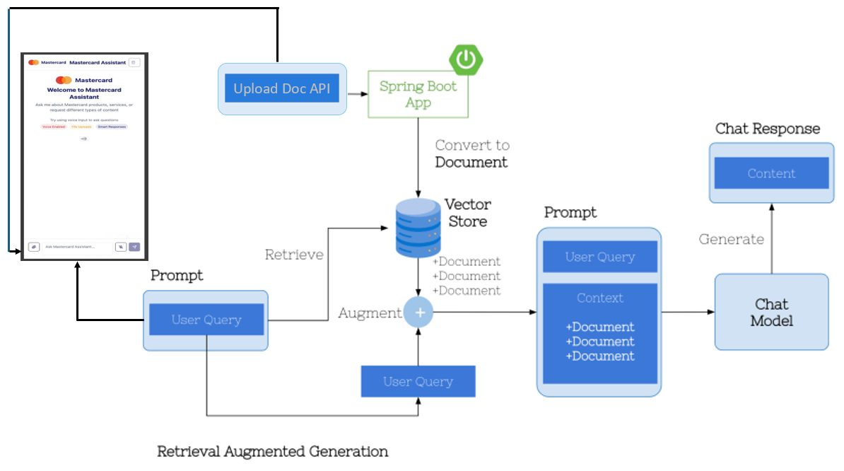
Assistant Bot Architecture

Slide 6
Mastercard Recommendation Bot Demo

Slide 7
Consideration : Deploying LLM Locally
Ollama is an open-source framework that lets you run LLMs locally on your machine.
No API costs—since you’re running models on-prem, there are no charges for requests.
Many open-source models (like LLaMA, Mistral, Gemma, and Code Llama) are free to use.
Potential Costs to Consider :
Hardware Costs – You need a good CPU/GPU to run larger models efficiently.
Storage & Memory – Large LLMs (e.g., LLaMA 70B) require more RAM & disk space.
Electricity Costs – Running LLMs locally consumes power, especially for GPUs.
Enterprise Support – If you need enterprise-level deployment (e.g., vector DB hosting), you might need paid services (e.g., Weaviate, Pinecone, Redis).

Slide 8
Benefits :
24/7 Availability
AI agents can offer round-the-clock support, improving overall customer satisfaction and loyalty
Cost Reduction
Businesses can reduce operational costs by leveraging AI for customer service,
allowing human agents to focus on more complex issues
Faster Response Time
Automates responses to common queries in real time
Eliminates wait times for Support team (CTS/DAS).
Provides instant access to relevant information using RAG
Multichannel Integration
Website chatbots
Voice bots via call center systems
Improved Customer Satisfaction & Retention
Quick, reliable, and consistent responses lead to better customer experiences.
Enhances customer trust by providing accurate and up-to-date information.

Slide 9
Use cases :
Microsoft Teams Recordings (KTs or Grooming) for Developer Support
Convert audio/video meetings into text using speech-to-text services like Azure Speech-to-Text
Store the transcribed text in a vector database for semantic search
When a developer asks a question, RAG retrieves relevant sections from transcribed meetings and summarizes key insights
Defect Management System
Faster Root Cause Analysis
Defect Resolution Suggestions
Defect Trends & Analytics
Product Onboarding & User Guides
Assists customers with setting up and using a product.
Knowing different product services offered
Regulatory Compliance Assistance
Financial institutions need up-to-date compliance guidance for laws like PCI DSS, GDPR, and AML
RAG fetches the latest compliance policies and audit reports to help teams stay compliant.

Slide 10

Thank You for the Opportunity

Slide 11
Appendix

Slide 12
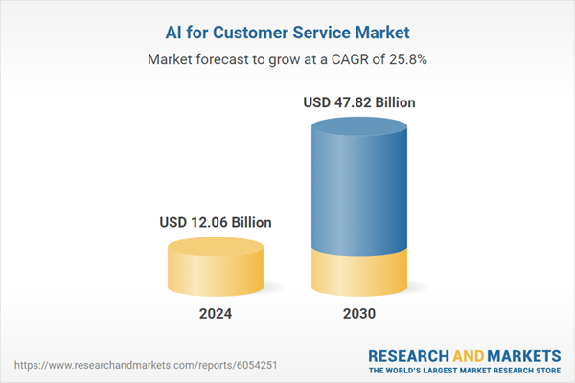
Why Recommendation bot :
AI for Customer Service Market by Product Type (AI Agents, Recommendation Systems (Knowledge Base Platforms),
Workflow Automation (RPA, CRM Automation), Content Generation, Customer Journey Analytics, Service Quality Management) –
Global Forecast to 2030. refer link
By 2030, 80% of routine operations will be handled by AI without human interaction .refer link

Slide 13
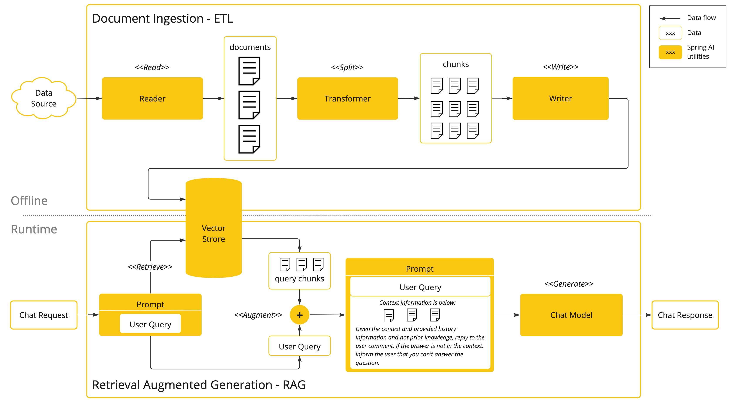
Spring AI RAG

Slide 14
Traditional PDF Search vs Spring AI RAG Search
Feature | Traditional PDF Search | Spring AI RAG
Search Mechanism | Keyword-based | Context-aware
Result Type | Exact text match | AI-generated response
Multi-document Search | Limited | Scalable across sources
Context Understanding | No | Yes
Integration with AI | No | Yes

